Slide 1
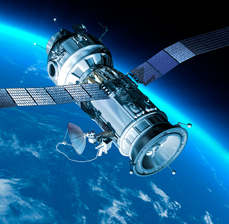
Road Features from Satellite Imagery
Binit Bhagat
19 Sept 2021

Slide 2
Data Analysis
Dataset consist of the following:
Training
Input
1105 images
Output
804 masks
Testing
Input
13 images
Output
13 masks
Training images and masks should be equal in number

Slide 3
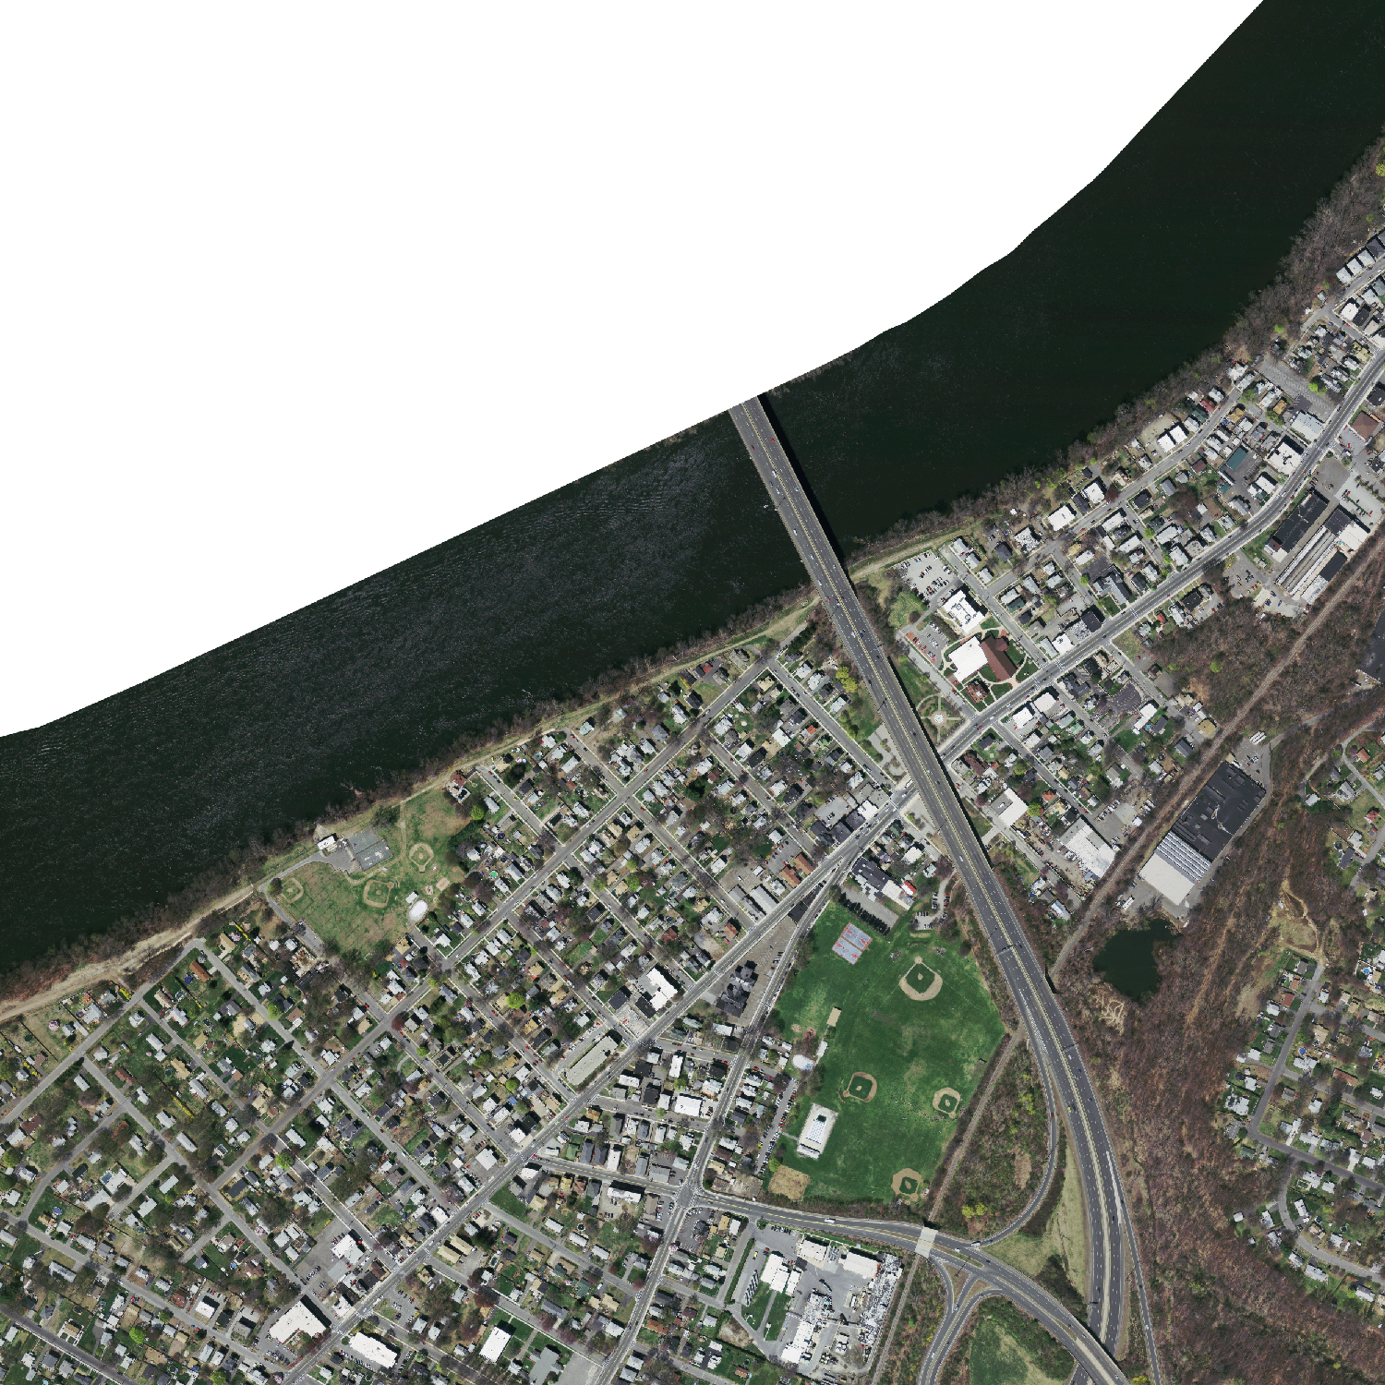
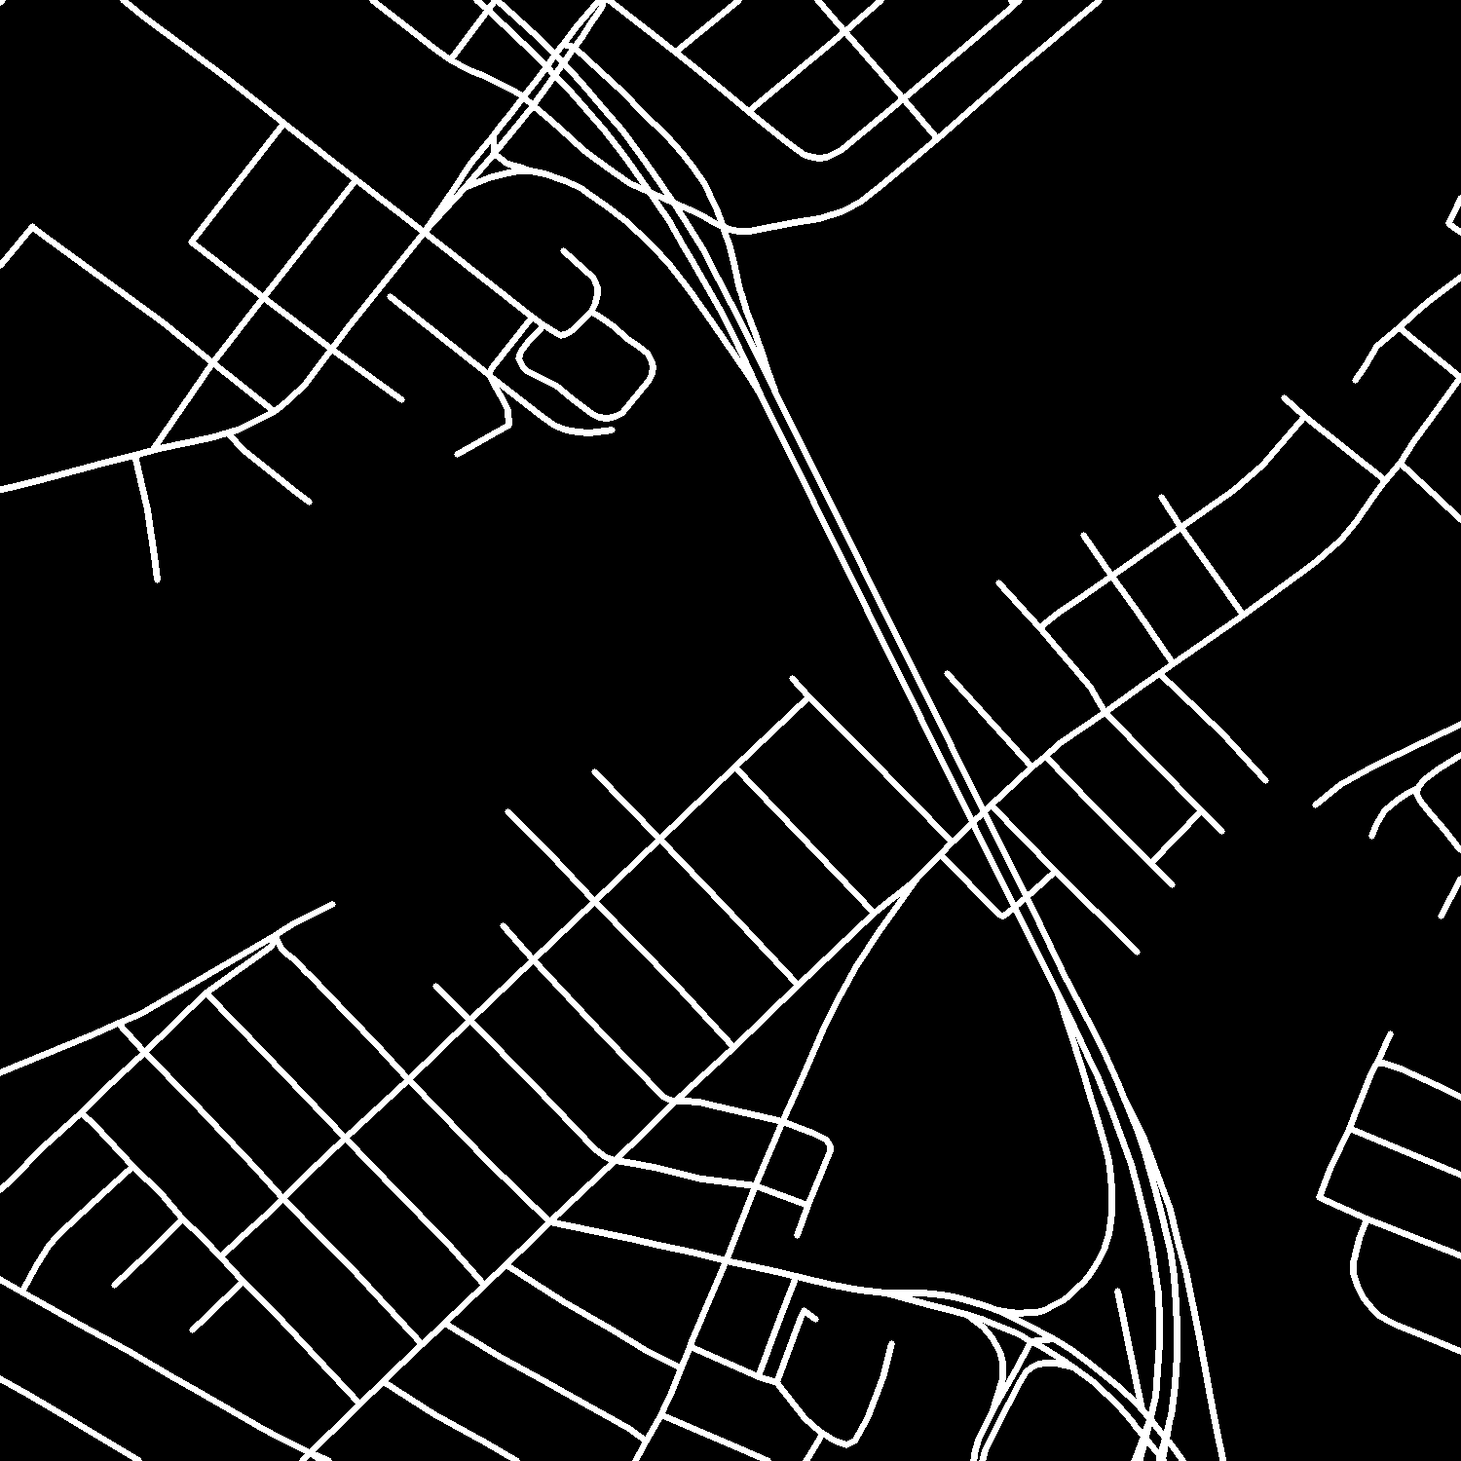
Data Analysis
It is noticed during analysis that some input images has blank/white areas, but their corresponding output mask has road annotations.

Slide 4
Data Analysis
Size of the input images (1500, 1500) is very large – it may take very long time to train CNN model.
So, we can resize or crop the image.
Resizing (1500, 1500) to (256, 256) may not be a great option, thus cropping may work.
Cropping / tiling (1500, 1500) for (256, 256) is huge reduction (might mess spatial features)
Also, it renders significant part of original image unusable (Fig.1)
1500 // 256 = 5. 1500 % 256 = 220
So, better to crop with (250, 250) chunks and later
resize the crops to (256, 256) which is a minimal resizing.
This way we can utilize most of the input features and
also have (256, 256) image size is suitable for U-Net
model training.
1500
220
1500
220
Fig.1

Slide 5
Data Analysis
Threshold binarize:
The masks may have other than black (0) and white (255) pixels with value between (0, 255). All these gray pixel will be treated as separate classes which is not desirable.
So, we may fix a threshold (50 by trial) above which all pixels are considered white and below which all black. This binarizes the output pixel values to either 0 or 255
White / black pixel ratio:
Training images with <= 1% white/black pixel ratio are omitted from training

Slide 6
Data Preprocessing Steps
Training images and masks are mapped 1:1 and excess removed (method: map_train_images)
Faulty images (blank areas) are determined manually (53) and removed images & masks
Crop each input image and mask into chunks of size (250, 250), thus producing 36 chunks
Threshold binarize: convert output masks to have either black or white pixels.
Training images and their masks with <= 1% white/black pixel ratio are omitted from training
Multiple Data sanity checks performed to ensure validity of training data
Resized each image from (250, 250) to (256, 256) before model training

Slide 7
Data Preparation – Model Training
Google drive mounted on Google Colab notebook
Copying images and masks to Google drive had many duplicate images and masks.
All these duplicates are found and removed from respective folders.
All images and masks resized to (256, 256) before model training.
Training and Validation data generated using data_generator class – it returns a generator of zipped images and their masks as per the batch_size supplied to the class (ref: Keras documentation)
Train and Val datasets verified for correct size of the array
Train image: (16, 256, 256, 3) Train mask: (16, 256, 256, 1)
Val image: (16, 256, 256, 3) Val mask: (16, 256, 256, 1)
Also verified that masks should have only normalized 1 and 0 representing white and black pixels
U-Net model is defined (ref: Keras documentation)
I changed metrics to IoU while compiling model because IoU is important for us.
Model wasn’t converging well because val_loss wasn’t decreasing while IoU was increasing. A better strategy could be monitor IoU in ModelCheckpoint instead of val_loss.

Slide 8
Model Training - Prediction

Slide 9
Result on Test Data
Following are the results on the test data from the first trained model
Mean_IoU = 0.54
Accuracy = 0.91
Precision = 0.62
Recall = 0.59
Precision and Recall are averaged at ‘macro’ level.
Weighted average has much higher value since the background (label 0) is huge majority.
Following are the results on test data from the finally trained model
Mean_IoU =
Accuracy =
Precision =
Recall =

Slide 10
Challenges And Learnings:
Not having a dedicated GPU env, I used Google Colab, but faced a lot of challenges
Data copied from local to Google drive – it took around 8 hours to upload 21K images & 21K masks
Model training was very slow – GPU not available constant, Runtime disconnects on inactivity.
Notebook crashed due to insufficient RAM.
Copying images to Google drive created duplicates that wasted lot of time
It was an experiment to crop (250, 250) and resize to (256, 256). But it many preprocessing tasks. So, I might have planned accordingly and cropped (256, 256) to save time.
Stitching back test images to create original test images and their predicted masks was a time consuming but good learning experience.
I tried to implement different model architecture, but data processing could not be completed in couple of hours, so had to drop the idea.

Slide 11
Scope For Improvement
On a dedicated GPU system experiments could be faster and more hyperparameters tuning.
Data augmentation could have been tried.
Tuning the model with different optimizers, loss functions could be done.
Maybe cropping with (256, 256) could have better result, but (250, 250) crop was an experiment.
Another thought behind (250, 250) crop was that it was easy to stitch the crops together to form the original test images / predictions.
I Experimented with a new model architecture with activation function ‘elu’, kernel_initializer='he_normal’ and Dropouts. The results are much better than the previous model.
We may also use transfer learning with VGG or Resnet models in the Encoder part of the U-Net.

Slide 12
Thanks

